Slide 1
Movement detection using wifi signals
SUBMITTED BY:
TAMIL SELVAN C(2016105073)
YUGESH V(2016105607)
DHANUSH L(2016105521)
GUHEN D(2016105532)
GUIDE:
Mrs N Vijaya
Associate professor
ECE Dept,CEG,Chennai

Slide 2
Need for this:
There has been an increasing interest in offloading the functionality of user's smart devices to the infrastructure surrounding the user.
Numerous applications can be enabled with the realization of smart spaces
With the emergence of smart space, sensing functionality can be performed by the environment

Slide 3
Objective:
To present a method which finds the movement within the range of wifi signal in our homes
Here we make the use of existing WiFi access points and WiFi devices (e.g., desktops, smartTVs, laptops).
There should not be any extra devices used apart from our regular routers and laptops

Slide 4
Our project is mainly focused on the CSI information of the received signal.
This can be done with routers without any external components
But we are simulating router’s properties to a laptop
So we should need a NIC that is compatible for overwriting and as well as a compatible laptop

Slide 5
The major advantage is that when 802.11n antennas has the properties of MIMO.
So, as the number of antennas increases there will be an increase in the accuracy of the csi extraction

Slide 6
System requirements
Ubuntu 14.04lts
Kernel version 4.1.10+
Compatible laptops
Min RAM 6GB
Atheros 802.11n NIC’s

Slide 7
Step by step processing: (common for both transmitter and receiver)
Buy components
Installing in compatable laptops
Installing Ubuntu 14.04 LTS in those laptops
Driver installation for wifi NICs
Installing ncurses

Slide 8
Setting up transmitter
Installing libnl,libssl packages
Configuring wifi interfaces
Installing ISC-DHCP Server
Assigning IPs for connections

Slide 9
Setting up receiver:
Making menu config files
Taking rx packets and analysing data it contains
Reading the Buffer files
Retriving csi information from kernel

Slide 10
SERVER
CLIENT
NIC
NIC
CSI processing

Slide 11
Problems faced:
Kernel error
Libnl error
Receiving CSI errors
Server error

Slide 12
Hotspot is turned on.
Our client laptop is connected to this hotspot.

Slide 13
Raw packets are sent through our user created socket.

Slide 14
Initially our client laptop is made to receive our user defined sequence.

Slide 15
After sending some sequences we terminate our receiving process.

Slide 16
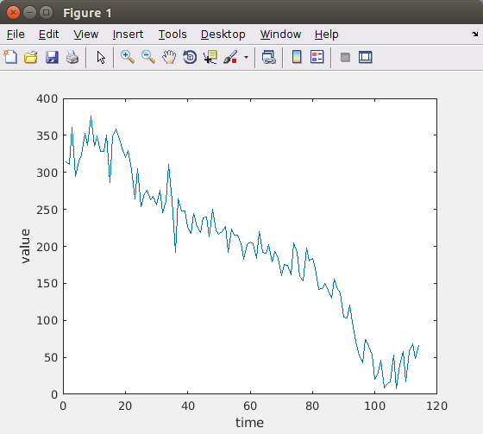
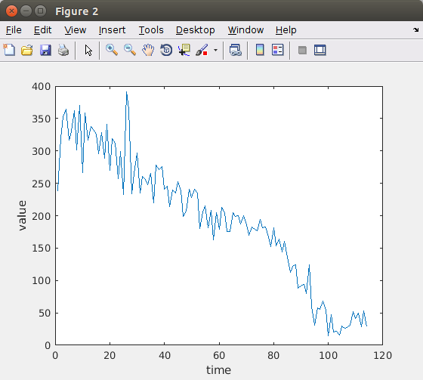
Csi values for first two sub-carriers of 1st package

Slide 17
Thank you!!

